Slide 1
Data types
JC08-4.1
(A. Nguyen)

Slide 2
Values in Java
A value in Java is:
A reference to an object, or
One of 8 primitive data types
We will concentrate on 4 primitive data types:
Note: a 10-digit phone number would overflow an int – will need long
TYPE | DESCRIPTION | SIZE
int | The integer type, with range -2,147,483,648 (Integer.MIN_VALUE) . . . 2,147,483,647 (Integer.MAX_VALUE) | 4 bytes
double | The double-precision floating-point type, with a range of about ±10³⁰⁸, and about 15 significant decimal digits | 8 bytes
char | The character type, representing code units in the Unicode encoding scheme | 2 bytes
boolean | The type with the two truth values false and true | 1 bit

Slide 3
int in Java
[1.5]
 | VALUE | COMMENTS
Integer.MIN_VALUE | -2³¹ or -2,147,483,648
Integer.MIN_VALUE-1 | 2147483647 | Overflow, becoming positive!
Integer.MIN_VALUE+1 | -2,147,483,647
Integer.MAX_VALUE | 2³¹-1 or 2,147,483,647
Integer.MAX_VALUE-1 | 2147483646
Integer.MAX_VALUE+1 | -2147483648 | Overflow, becoming negative!

Slide 4
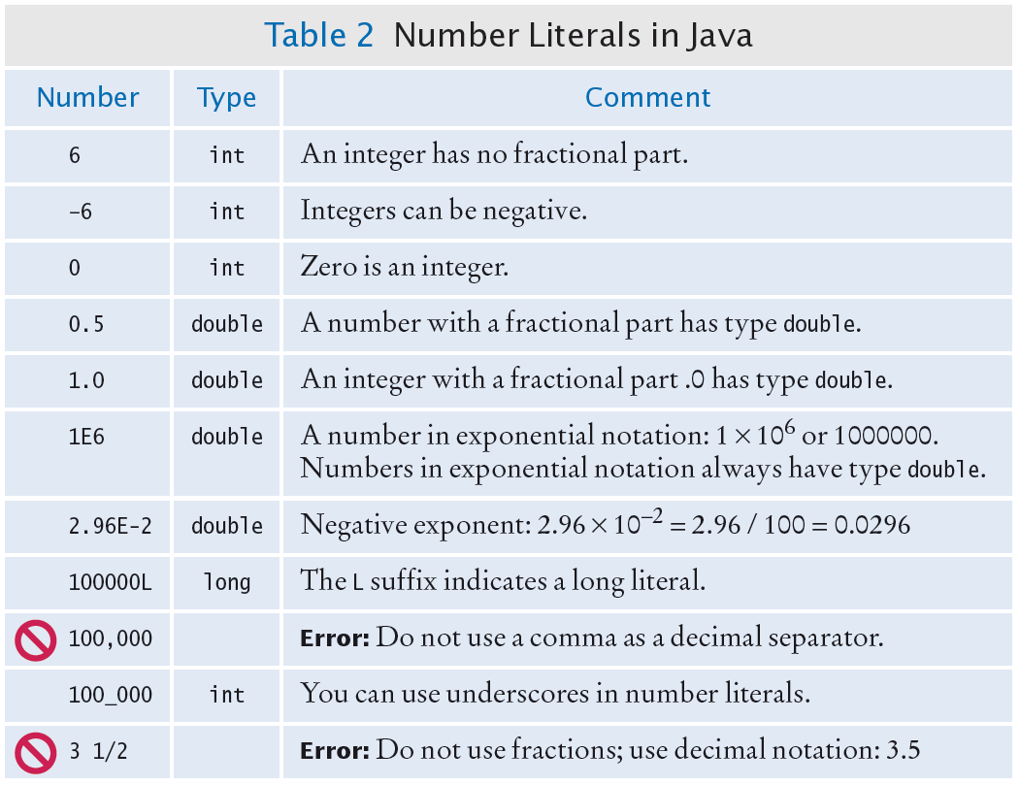
Number Literals (& errors)
From Java Concepts, 8e, C. Horstmann

Slide 5

Rounding Errors
From Java Concepts, 8e, C. Horstmann
Rounding errors occur when an exact representation of a floating-point number is not possible.
Floating-point numbers have limited precision. Not every value can be represented precisely, and roundoff errors can occur.
Example
double f = 4.35;
System.out.println(100 * f); // Prints 434.99999999999994

Slide 6
Convert or cast
JM02-6.4
The quickest way to convert a number to a string is to concatenate (i.e., with addition symbol) it with an empty string (i.e., a pair of double quotes): “” + 2 + 3 is the string 23 (i.e., not integer 23)
Java automatically converts a “smaller” number to a “larger” one:
int n = 2;
double x = n; // OK to put an int into a double
The programmer must explicitly convert or cast a “larger” number to a “smaller” one:
double x = 3.6;
int n = (int)x; // cast a double to an int

Slide 7
final and static
Reserved word final indicates that the value is a constant, i.e., once assigned, the value cannot be changed (or else syntax error) – note that the reserved word is NOT const:
final static double QUARTER_VALUE = 0.25;
double circumference = Math.PI * diameter;
Final values are named with upper-case letters and underscores
Reserved word static indicates that the value belongs to the class; i.e., only one slot of RAM to be shared by all live objects:
final static double QUARTER_VALUE = 0.25;
static Color.BLACK

Slide 8
Why Symbolic Constants?
[6.5]
Easy (for the programmer) to change the value throughout the program, if necessary
Easy to change into a variable
More readable, self-documenting code
Additional data type checking by the compiler
Notes:
But there is no need for symbolic constants like
pubic final int ONE = 1;

Slide 9
Math class – see Java API
Values (name in upper case only) – static:
pi value: Math.PI
Euler’s number e: Math.E
Some methods (name starts with lower case), returning double:
Get power value: Math.pow(double base, double exponent)
Get random number in [0, 1) interval: Math.random()
Get natural log value: Math.sqrt(double someNumber)
Get natural log value: Math.round(double someNumber)
Get natural log value: Math.log(double someNumber)
Get common log value: Math.log10(double someNumber)
Get sin value: Math.sin(double someAngle)

Slide 10
Operations
JC08-4.1
(A. Nguyen)

Slide 11
Arithmetic
[6.7]
Operators: +, -, /, * , %
The precedence of operators & parentheses is the same as in algebra (PMDAS)
Exp. is Math.pow(double base, double exp)
m % n means the remainder when m is divided by n:
17 % 5 is 2
3 % 8 is 3
To check whether an integer n is even: if (n % 2 == 0)
% has the same rank as / and *
Same-rank binary operators are performed in order from left to right
Notes:
There is also the unary operator -, for example,
sign = -sign;
All unary operators have a higher rank than binary operators and are executed first.

Slide 12
Arithmetic (cont’d)
[6.7]
The type of the result is determined by the types of the operands, not their values; this rule applies to all intermediate results in expressions. If both operands are of the same type, then the result is that type; otherwise, it is of the “larger” type.
If one operand is an int and another is a double, the result is a double; if both operands are ints, the result is an int.
Notes:
If an expression has several binary operators of the same rank with no parentheses, the intermediate results are calculated from left to right. For example:
x = a / b * c;
is the same as
temp = a / b;
x = temp * c;

Slide 13
Arithmetic (cont’d)
[6.7]
Caution: if a and b are ints, then a / b is truncated to an int…
17 / 5 gives 3
3 / 4 gives 0
…even if you assign the result to a double:
double ratio = 2 / 3; // this is int division
The double type of the result doesn’t help: ratio still gets the value 0.0.
Notes:
This is another place to be very careful.
Integer truncation can be useful. For example, find the whole number of weeks in a given number of days or the number of whole hours in a given number of minutes:
int fullWeekCount = dayCount / 7;
System.out.println(mins / 60 +
" hours and " + mins % 60 + " minutes.");

Slide 14
Arithmetic (cont’d)
[6.7]
To get the correct double result, use double constants or the cast operator:
double ratio = 2.0 / 3;
double ratio = 2 / 3.0;
int m = ..., n = ...;
double factor = (double)m / (double)n;
double factor = (double)m / n;
double r2 = n / 2.0;
Casts
Notes:
Another reason for symbolic constants: if you declare a symbolic constant as a double, then casts to double are unnecessary and arithmetic errors are avoided.
A few redundant casts are OK, and they make your code self-documenting.

Slide 15
Arithmetic (cont’d)
[6.8]
Compound assignment operators:
a = a + b; a += b;
a = a - b; a -= b;
a = a * b; a *= b;
a = a / b; a /= b;
a = a % b; a %= b;
Increment and decrement operators:
a = a + 1; a++;
a = a - 1; a--;
Do not use these in longer expressions
Notes:
a = a + b;
gives away a novice. But so does
a += a + b++;

Slide 16
Formatted “print”
There is printf (“f” is for formatted)
For example:
int m = 5, d = 19, y = 2007;
double amt = 123.5;
System.out.printf ( "Date: %02d/%02d/%d Amount = %7.2f\n", m, d, y, amt);
displays:
Date: 05/19/2007 Amount = 123.50
%2d asks for 2 spaces for a decimal (i.e., base 10), or integer; %d asks for enough spaces to display an integer
%7.2f asks for 7 spaces for floating-point number, including the decimal point and 2 places for the decimal part

Slide 17
Scope
JC08-4.1
(A. Nguyen)

Slide 18
Definition of scope
The scope of a variable is the area of the code where the variable is “visible”

Slide 19
Local Variables
[6.2]
Local variables are declared inside a constructor or a method.
Local variables lose their values and are destroyed once the constructor or the method is exited.
The scope of a local variable is from its declaration down to the closing brace of the block in which it is declared.
Notes:
If you create a temporary object in a method using new and then assign it to a local variable, then the object is destroyed automatically when the method is exited and its memory is released. Java has a “garbage collector" run-time mechanism to do that.

Slide 20
Scope of variables
[6.2]
Each variable has a scope — the area in the source code where it is “visible.”
If you use a variable outside its scope, the compiler reports a syntax error.
Variables can have the same name when their scopes do NOT overlap.
{
int k = ...;
...
}
for (int k = ...)
{
...
}
Notes:
So scope is a compile-time concept, not a run-time concept. The compiler reports a syntax error, “Cannot resolve symbol.”
If the scopes of two variables overlap, the variable defined in the inner scope takes precedence over the variable with the same name in the outer scope. It is easy to make a mistake and override a field with a local variable of the same name, as explained later.

Slide 21
Scope of variables (cont.)
[6.2]
public class SomeClass
{
...
public SomeType SomeMethod (...)
{
{
}
}
...
}
Local variable declared
Scope
Local variable declared
Notes:
You can declare a local variable inside a for loop:
for (int i = 0; i < 100; i++)
The scope of such a variable is the body of the loop within braces, so it is undefined after the loop.

Slide 22
Scope of fields
[6.2]
Fields are declared outside all constructors and methods.
Fields are usually grouped together, either at the top (or at the bottom) of the class.
The scope of a field is the whole class, which is why all methods of that class can use all the fields
Notes:
Local variables are for temporary use; they are created when you call a method and destroyed when you return from a method call. Fields have the lifetime of the object and are destroyed only when the object is destroyed.

Slide 23
Scope of fields (cont.)
[6.2]
public class SomeClass
{
}
Scope
Fields
Constructors and methods
Or:
public class SomeClass
{
}
Scope
Constructors and methods
Fields
Notes:
Regardless of where you place a field declaration, the field is “visible” in the whole class. The compiler scans the class’s code to locate and tabulate all the fields, then parses the code again and checks the syntax.
A field’s value can be set in its declaration, in a constructor, or in one of the methods. Uninitialized fields get default values: 0 for numbers, null for objects (references), false for booleans (see Chapter 7).

Slide 24
Variables (cont’d)
[6.2]
Common mistakes – class Circle w/ field radius:
private double radius; // auto. assigned: 0.0
...
public Circle (...) // constructor
{
double radius = 5;
...
}
Declares a local variable radius; the value of the field radius remains 0.0
Notes:
Again, give fields prominent names and write the data type designator for a field only in the field’s declaration, never inside a constructor or method. Attention to detail is the key.

Slide 25
____
JC08-4.1
(A. Nguyen)

Slide 26
__
__
__

Slide 27
THE END

Slide 28
3 kinds of variables: comparison
 | FIELD | LOCAL VARIABLE | (FORMAL) PARAMETER
pubic vs. private | must be specified; if not, same as public | not specified, or else compile error | not specified; or else compile error
initial value | defaulted as zero or null if not explicitly initialized | must be initialized before used, or else compile error | value same as passed from caller
assigned | assigned by any method in the class (if private); assigned by any method constructing the object (if public) | assigned after declared, within its scope | used (but not reassigned) by the called method Note: a copy of the param is made locally
scope (shown in different color boxes in BlueJ) | if private, scope is the entire class; if public, accessible & modifiable by clients (i.e., objects of other classes) | scope is from the declaration time until the ending brace of the block containing the declaration | scope is the called method (i.e., the method where the parameter is passed to)

Slide 29
How to choose data type
For info that is integers (e.g., student ID, room number), choose int
For info that is floating-point (e.g., money amount, GPA), choose double
For info that is one-character text (e.g., initial of middle name), choose char
For info that represents true/false or yes/no (e.g., whether a rectangle is a square, or whether an item has been found), choose boolean
NOTE: Make sure that the info will fit into the storage by the data type; an int is sufficient for a social security number, but not for area code + phone number

Slide 30
Return value
JC08-4.5
(A. Nguyen)

Slide 31
Characteristics of return
JM02-7
When a program encounters a return statement, it quits that method.
If the method does not require an output (i.e., void), then (1) return simply quits the method, (2) return is NOT REQUIRED if the method ends at the closing brace of the method’s body.
If the method requires an output/return, then (1) return must be followed by a value of the output/return data type, (2) return is REQUIRED, and is the last statement of the method for normal end.
A statement that follows a return statement (in the same block) will cause a syntax error.
A method that “returns” something means a method WITH OUTPUT; it does NOT mean a method that print or println something.

Slide 32
Example of return in a method w/o output
JM02-7
public void doSomething() ← void indicate no output
{
…
if ( … )
{
…
return; ← special-case return, in the middle of a method body
// no more statements here, or syntax error
}
else
…
…
} ← normal return, at the ending brace of a method body

Slide 33
Example of return in a method w/ output
JM02-7
public double calcArea(double radius) ← double indicates with output, of type double
{
double area = 0.0;
if (radius < 0.0 )
area = -1.0; // neg. area to indicate bad input
else
area = Math.PI * radius * radius;
return area; ← REQUIRED return, and WITH output
// no more statements here, or syntax error
}

Slide 34
To be cont.

